Slide 1
Employee Learning Journey
Impact Report
Presented to : CEO of Acme
Presented by : Rogeshwaran

Slide 2
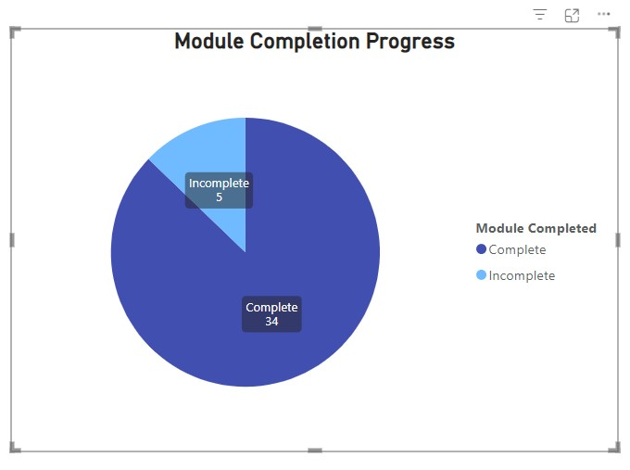
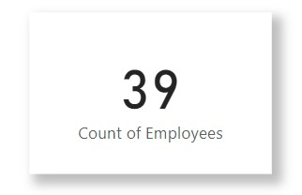

Slide 3
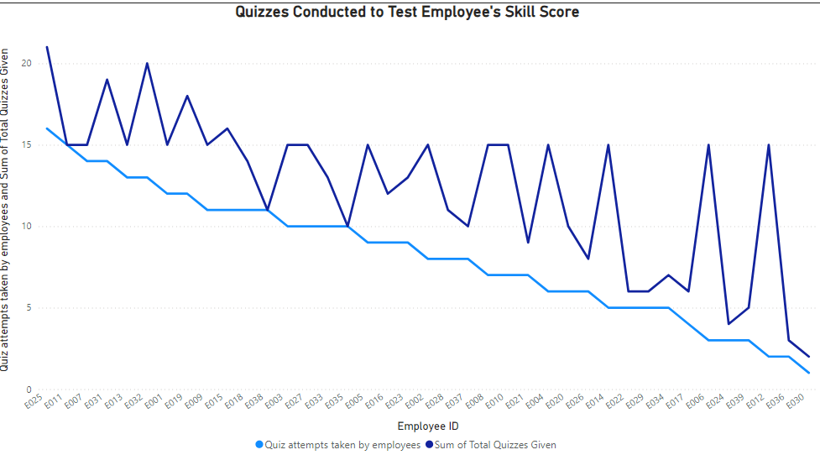

Slide 4
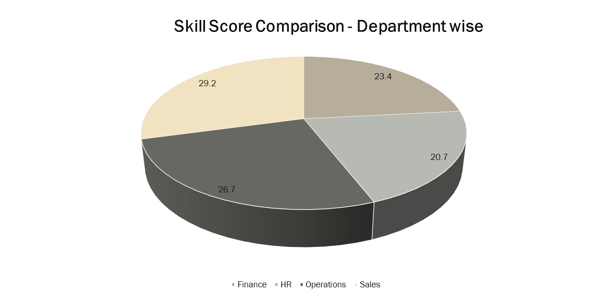

Slide 5
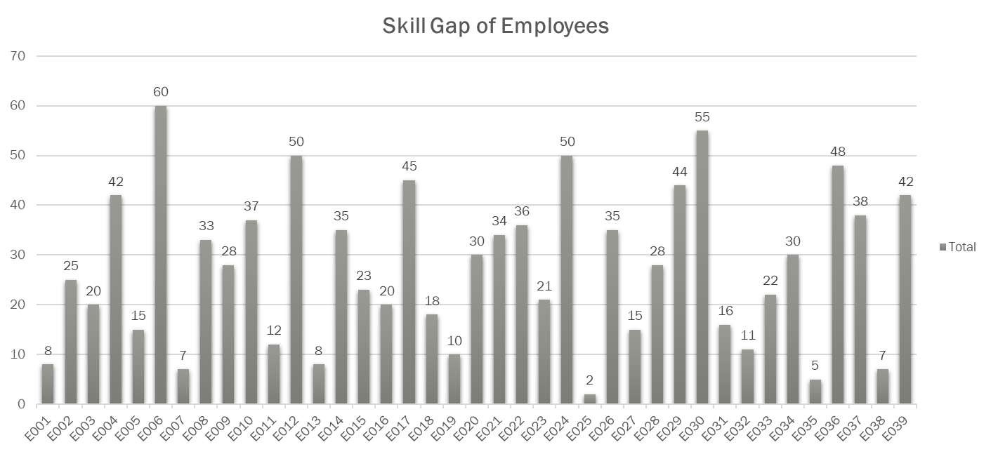

Slide 6
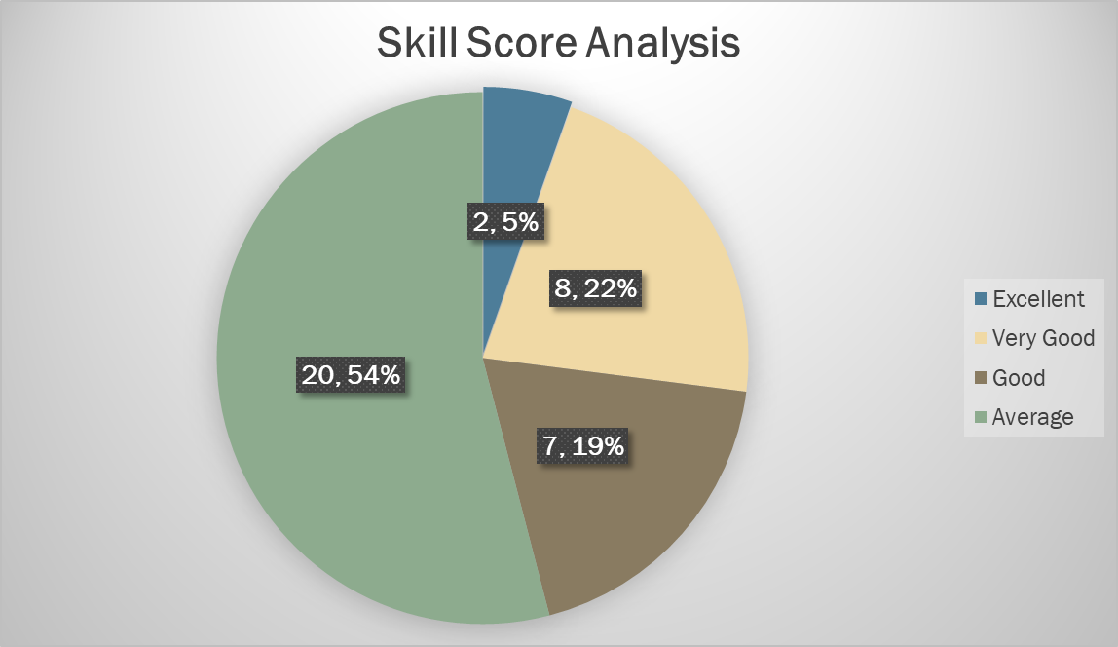

Slide 7
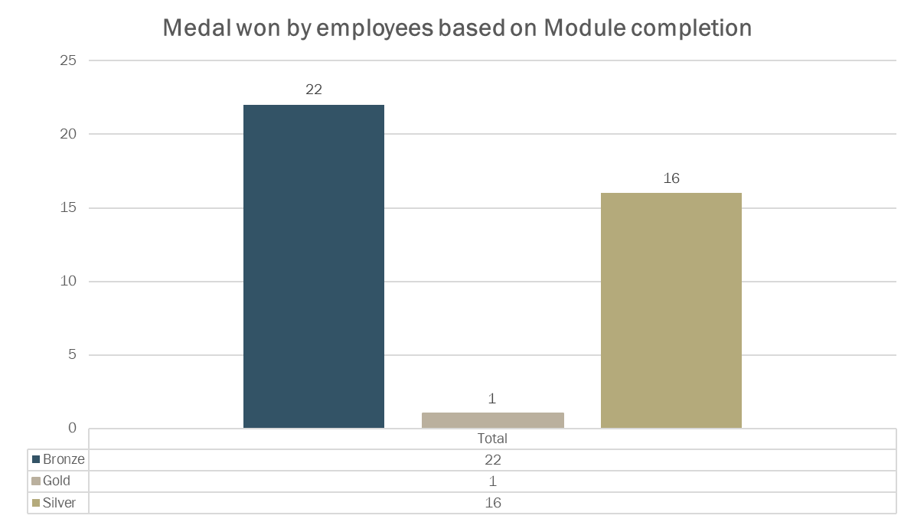

Slide 8
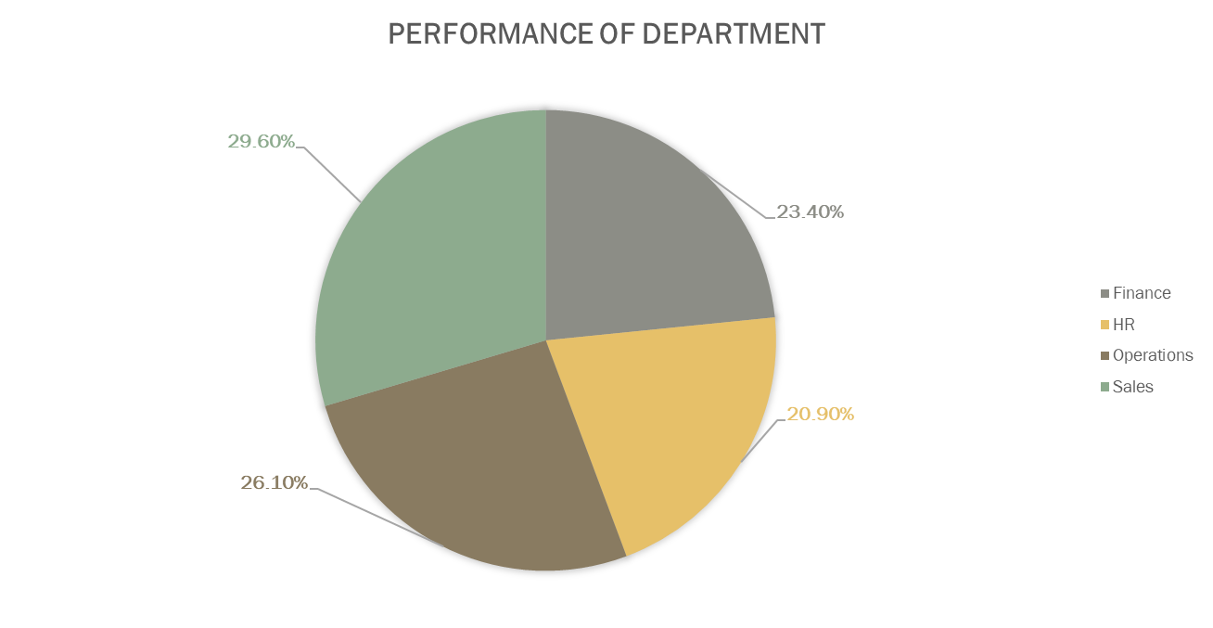

Slide 9
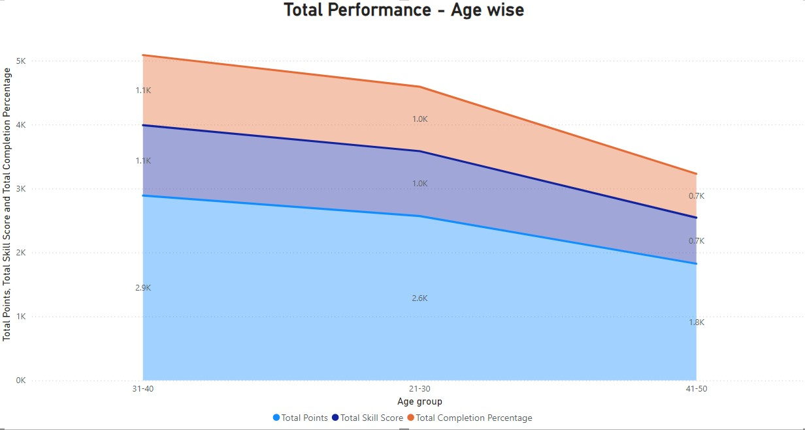

Slide 10
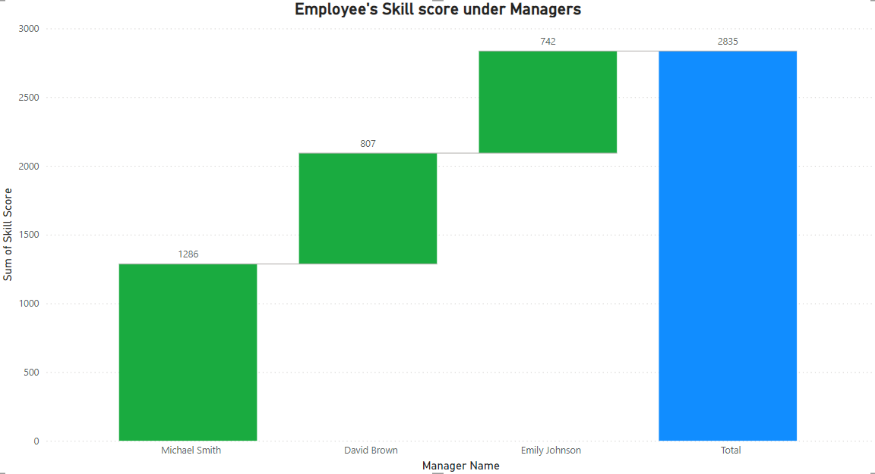

Slide 11
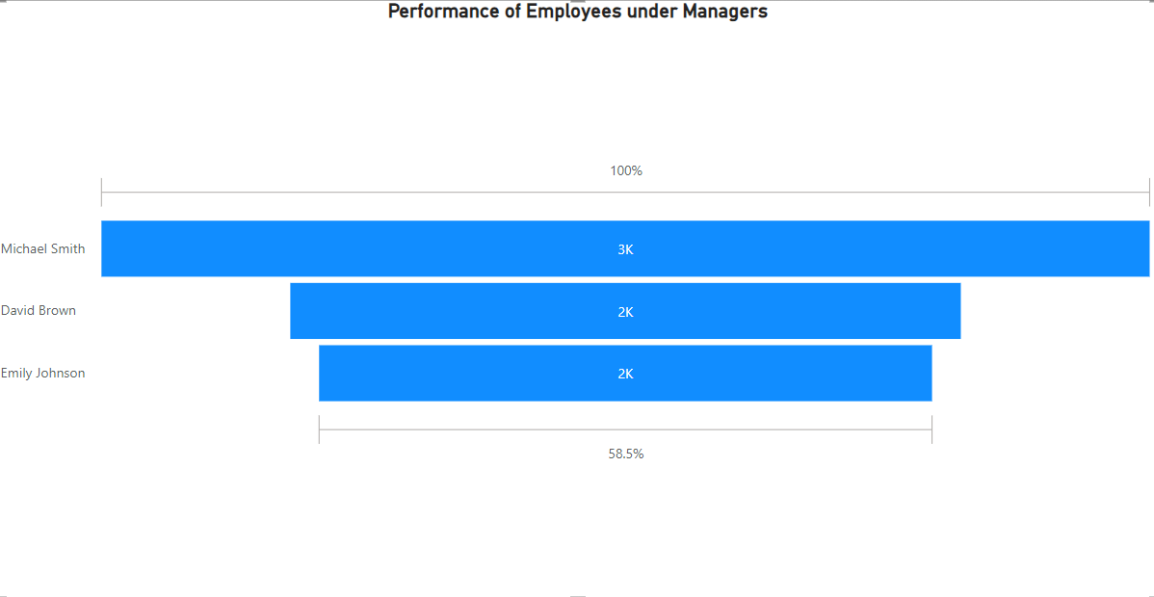

Slide 12
Key Performance Indicator,
With the objective of improving our organization’s efficiency, I would like to bring to your notice that I have an idea of starting a Learning Journey Program for our employees. Through this program, the employees will Learn about their skills and skill gaps. This program will be conducted with assessments for 2 weeks and also daily actions for 21 days. In this Learning Journey Program, we can conduct assessments, provide course materials like videos, and also conduct various quizzes to test their learning and we can obtain their skill scores from it. By Conducting this program, it helps to identify the skill gaps of employees and also the performance of every organizational hierarchy. The Employee Learning Journey Program helps in reducing the skill gaps of employees and so the employees are better prepared with improved skills. To keep the employees engaged, every activity in this module will be given “Points of Completion”. Employees who complete it on time will be rewarded with Gold/Silver/Bronze medals based on their skill score & performance. I have also presented various Business Insights of this program above and how much it has impacted our organization. This program isn’t just about learning, it’s about building a culture of growth and excellence. By investing in our people, we’re investing in the future success of our organization. So, I kindly request you to look after this and consider it.
______

